Slide 1
HCI Project 1
Lawzeem Latif

Slide 2
Microwave Design and Inspirations
Modern microwaves have too many options
Usually only ever want to input the time and change power settings
Even if multiple auto-cook settings are given, we can just use the power and time to replicate those
Various microwaves have their own settings for auto-cook and often lead to inconsistencies across devices and thus is unreliable

Slide 3
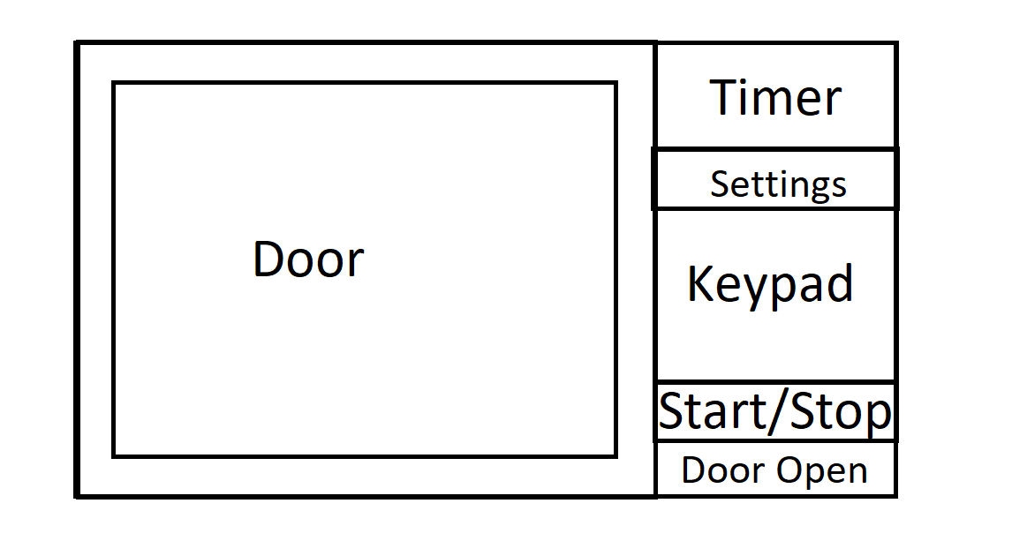
Rough Sketch

Slide 4
Design Ideas
The design is based off the microwave in my apartment but simplified
I never use the auto-cook settings
In addition, I wanted to keep things simple so new users can take a look and use it without messing with all sesttings

Slide 5
Microwave in operation

Slide 6
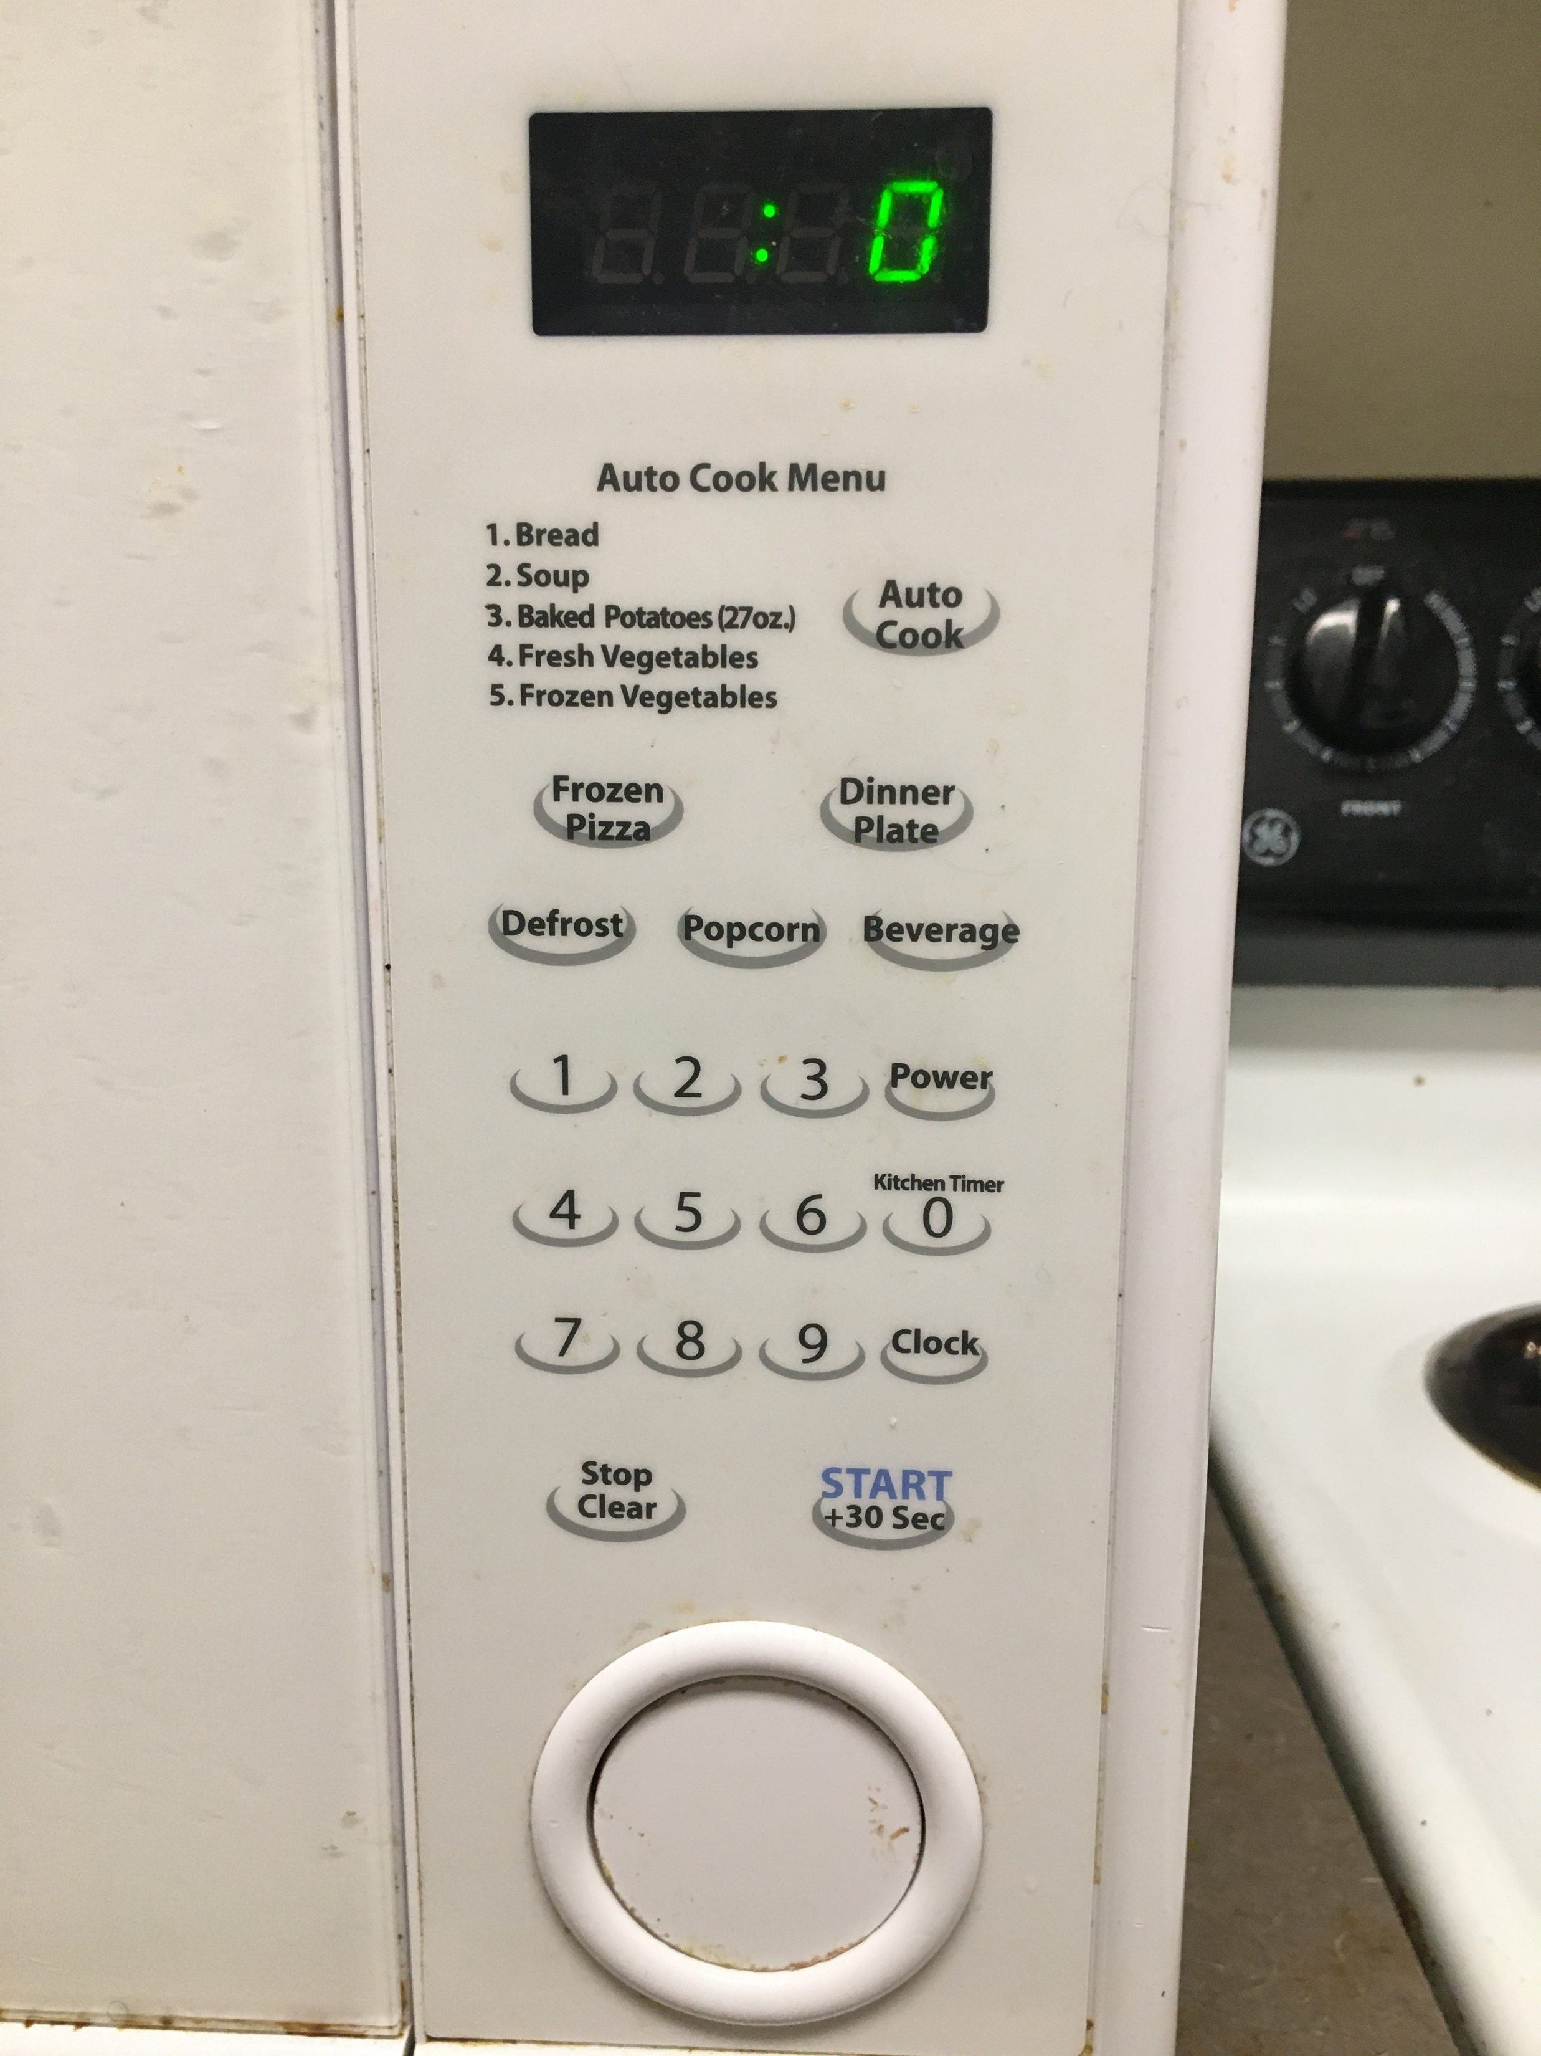
Control Panel
Auto Cook Menu is too complicated and inconsistent.
Beverage does not take into account the size of the cup or the amount of drink.
Frozen Pizza can vary in size.

Slide 7
My Design

Slide 8
Explanation for the Design
The design includes sound options for those with sight problems.
It also has indicators in the Power and Sound option to show what setting its on.
If I use the microwave at night, I don’t want there to be any noise to distract my family or my roommates.
I kept the design minimal because the auto-cook menu never worked for me and I had to microwave with a timer anyways.

Slide 9
Final thoughts
Modern microwaves are getting smarter
They are coming with many new technologies like connecting to the internet and voice assistants
This is complicating a simple device with a simple purpose or heating food
This leads to complications for new users who never used the technology before

